Slide 1
Statistics 3
Time Series
Forecasting based on historical data

Slide 2
Introduction
Observe the evolution a variable Y over time: Gathering and Viewing
Analyze a series for which the explanatory variable is time: Choosing a model and Decomposing the series
Develop short-term or medium-term forecasting models: Extrapolate & Forecast and Assess the quality of the model
6 steps !

Slide 3
The 6 steps
1. Gathering the data (historical data)
2. Viewing
3. Choosing a model
4. Decomposing the series
5. Extrapolating and forecasting
6. Assessing the quality of the model

Slide 4
Definition
A time series is a sequence of data points, of quantitative nature, measured typically at successive points in time spaced at uniform time intervals:
y(1), y(2), y(3), ..., y(t), ..., y(n)
where y(t) is the value of the variable Y at time t, and n is the length of the series (the number of data points).

Slide 5
The 6 steps
1. Gathering the data (historical data)
2. Viewing
3. Choosing a model
4. Decomposing the series
5. Extrapolating and forecasting
6. Assessing the quality of the model

Slide 6
Step 1. Gathering the data
Example: champagne sales.
 | 2005 | 2006 | 2007 |  | 2011 | 2012
January | 2815 | 2541 | 3113 | … | 2639 | 3934
February | 2672 | 2475 | 3006 | … | 2899 | 3162
March | 2755 | 3031 | 4047 | … | 3370 | 4286
April | 2721 | 3266 | 3523 | … | 3740 | 4676
May | 2946 | 3776 | 3937 | … | 2927 | 5010
Juin | 3036 | 3230 | 3986 | … | 3986 | 4874
July | 282 | 3028 | 3260 | … | 4217 | 4633
August | 2212 | 1759 | 1573 | … | 1738 | 1659
September | 2922 | 3595 | 3528 | … | 5221 | 5951
October | 4301 | 4474 | 5211 | … | 6424 | 6981
November | 5764 | 6838 | 7614 | … | 9842 | 9851
December | 7312 | 8357 | 9254 | … | 13996 | 14670
Notes:
Dans exemple 2 : ventes à préciser (unité de mesure)

Slide 7
The 6 steps
1. Gathering the data (historical data)
2. Viewing
3. Choosing a model
4. Decomposing the series
5. Extrapolating and forecasting
6. Assessing the quality of the model

Slide 8
Champagne sales
Step 2. Visualizing
Notes:
Times series chart, or Time Plot, also called Fever chart

Slide 9
Decomposing time series
In this course, we will consider that a time series is a juxtaposition of 3 components:
The (secular) Trend T describes the long-term movement and general evolution of the series. The trend may show persistent, overall upward or downward pattern.
The Seasonality (or seasonal variation) S describes the fluctuations in the time series that recur during specific time periods, i.e. periodic fluctuations (regular pattern of up and down). Most commonly, the period is a year (seasonal span: 12 months or 4 trimesters).
The Residual effect Ɛ is what remains, having removed the Trend and Seasonal components of a time series. It represents the random error effect of a time series, caused by unforeseen rare events such as wars, hurricanes, strikes, by randomness of human actions or any unexplained causal factors.
Each of the three components contributes to the determination of the value of Y(t) at each point in time.
Notes:
+the cyclical fluctuation

Slide 10
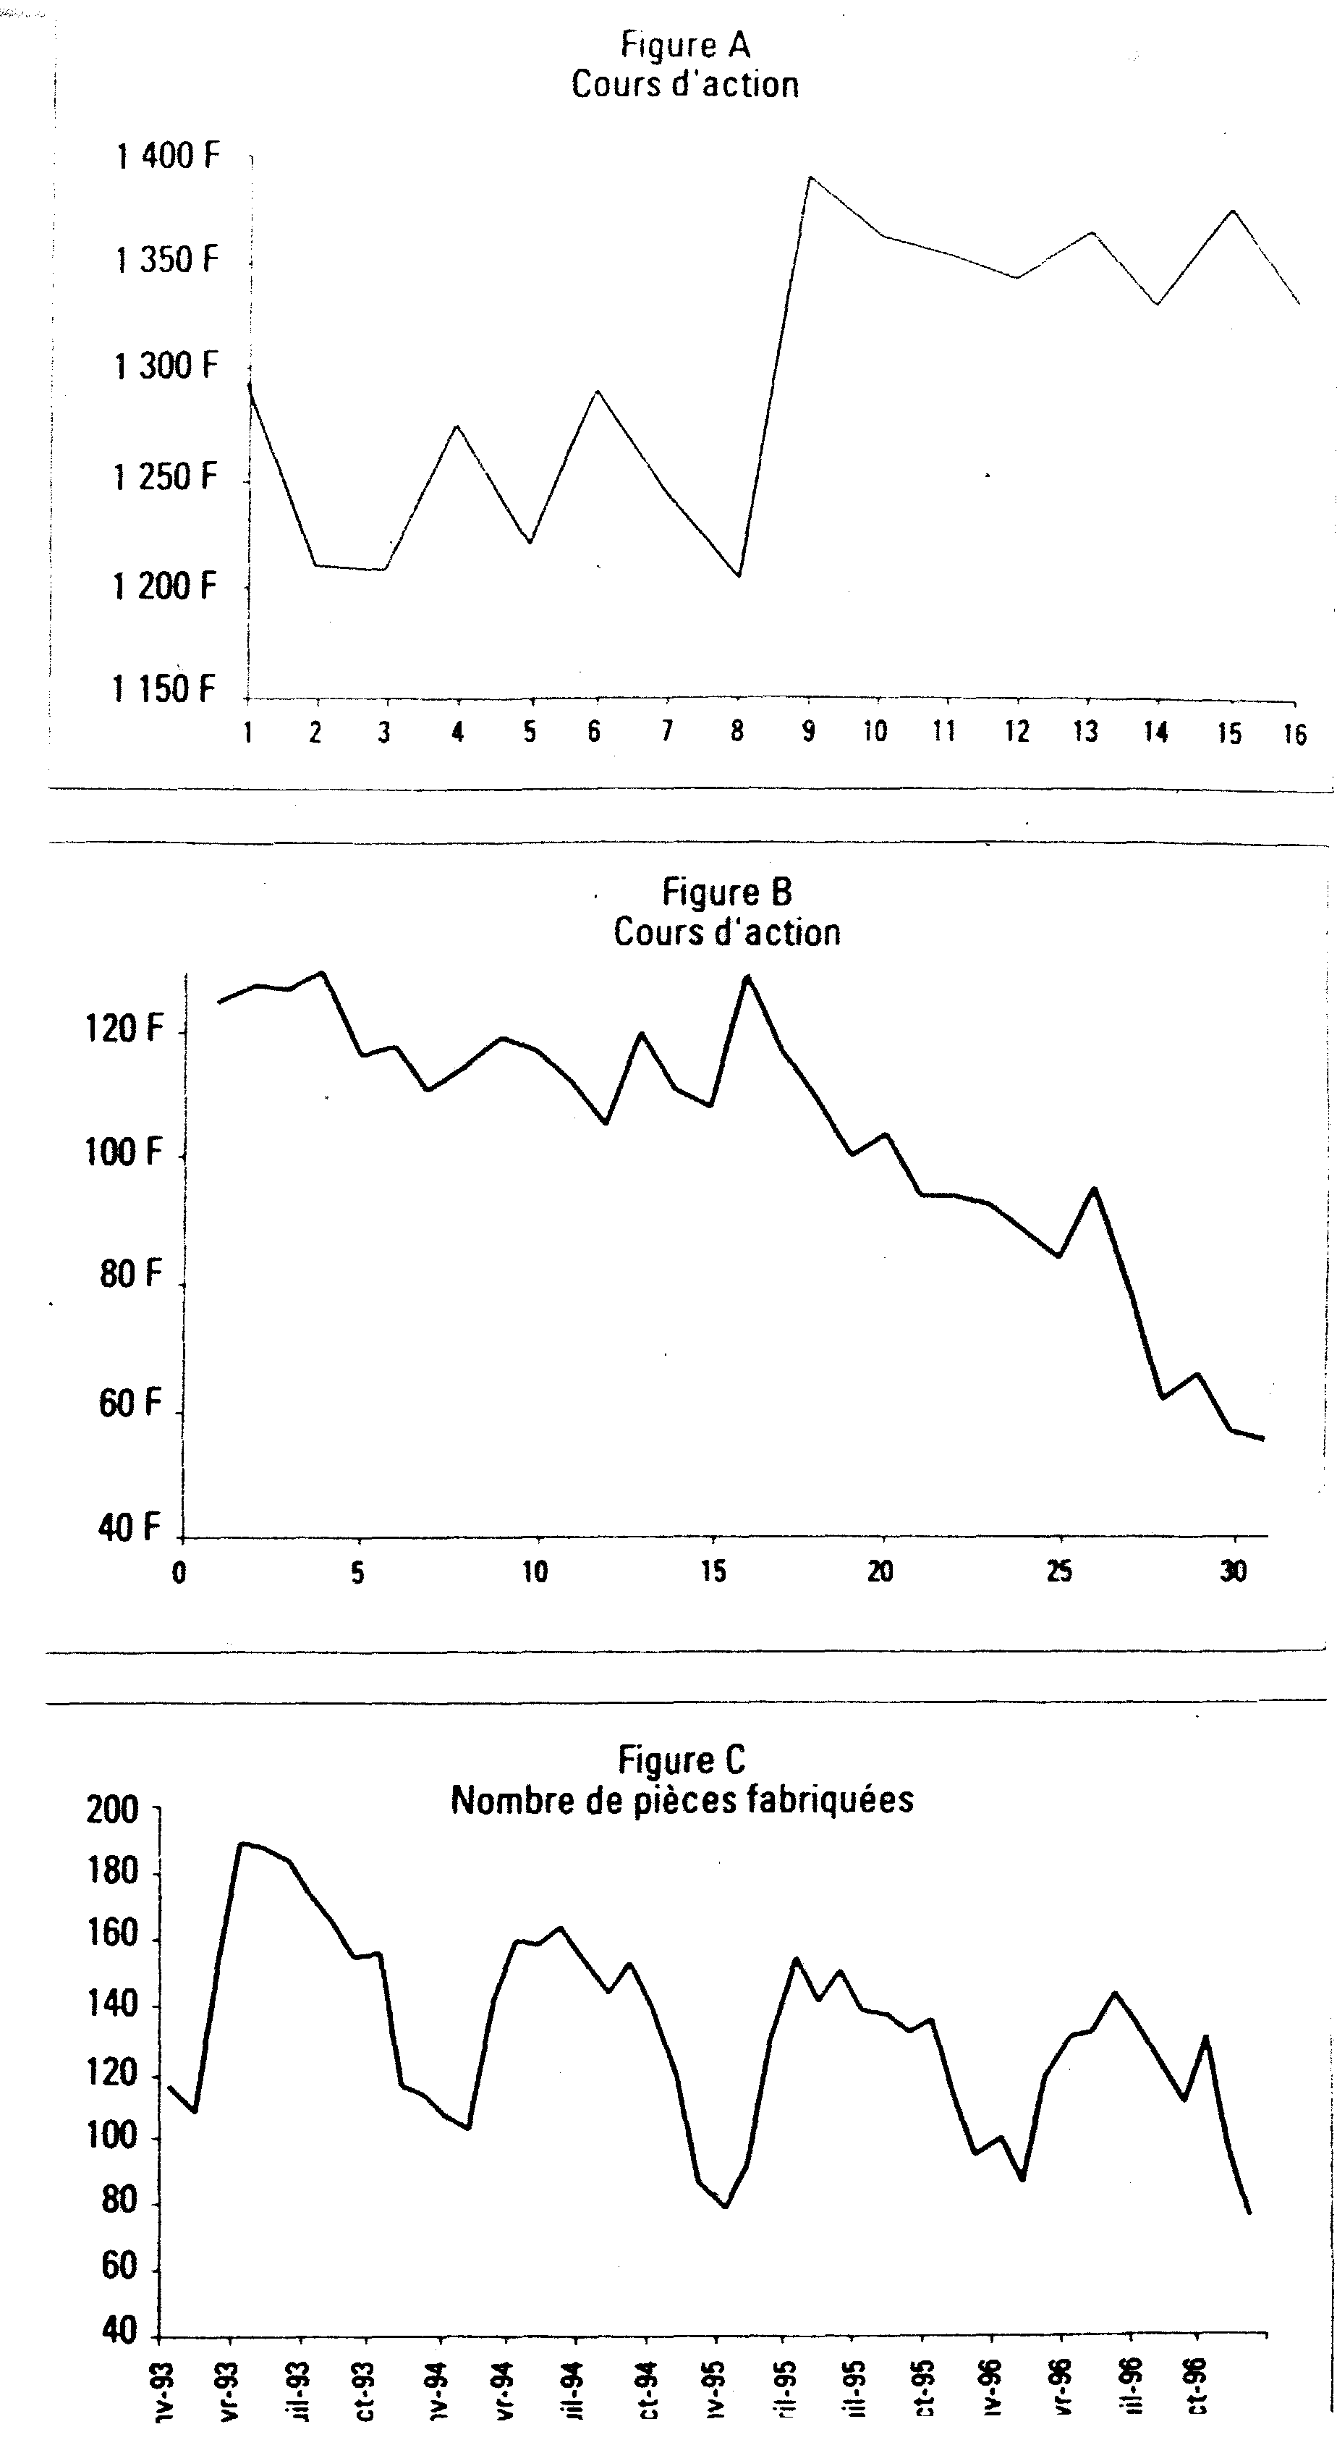
Examples of time series
Notes:
Figure A : Pas de tendance
Figure B : Tendance à la baisse
Figure C : Saisonnalité

Slide 11
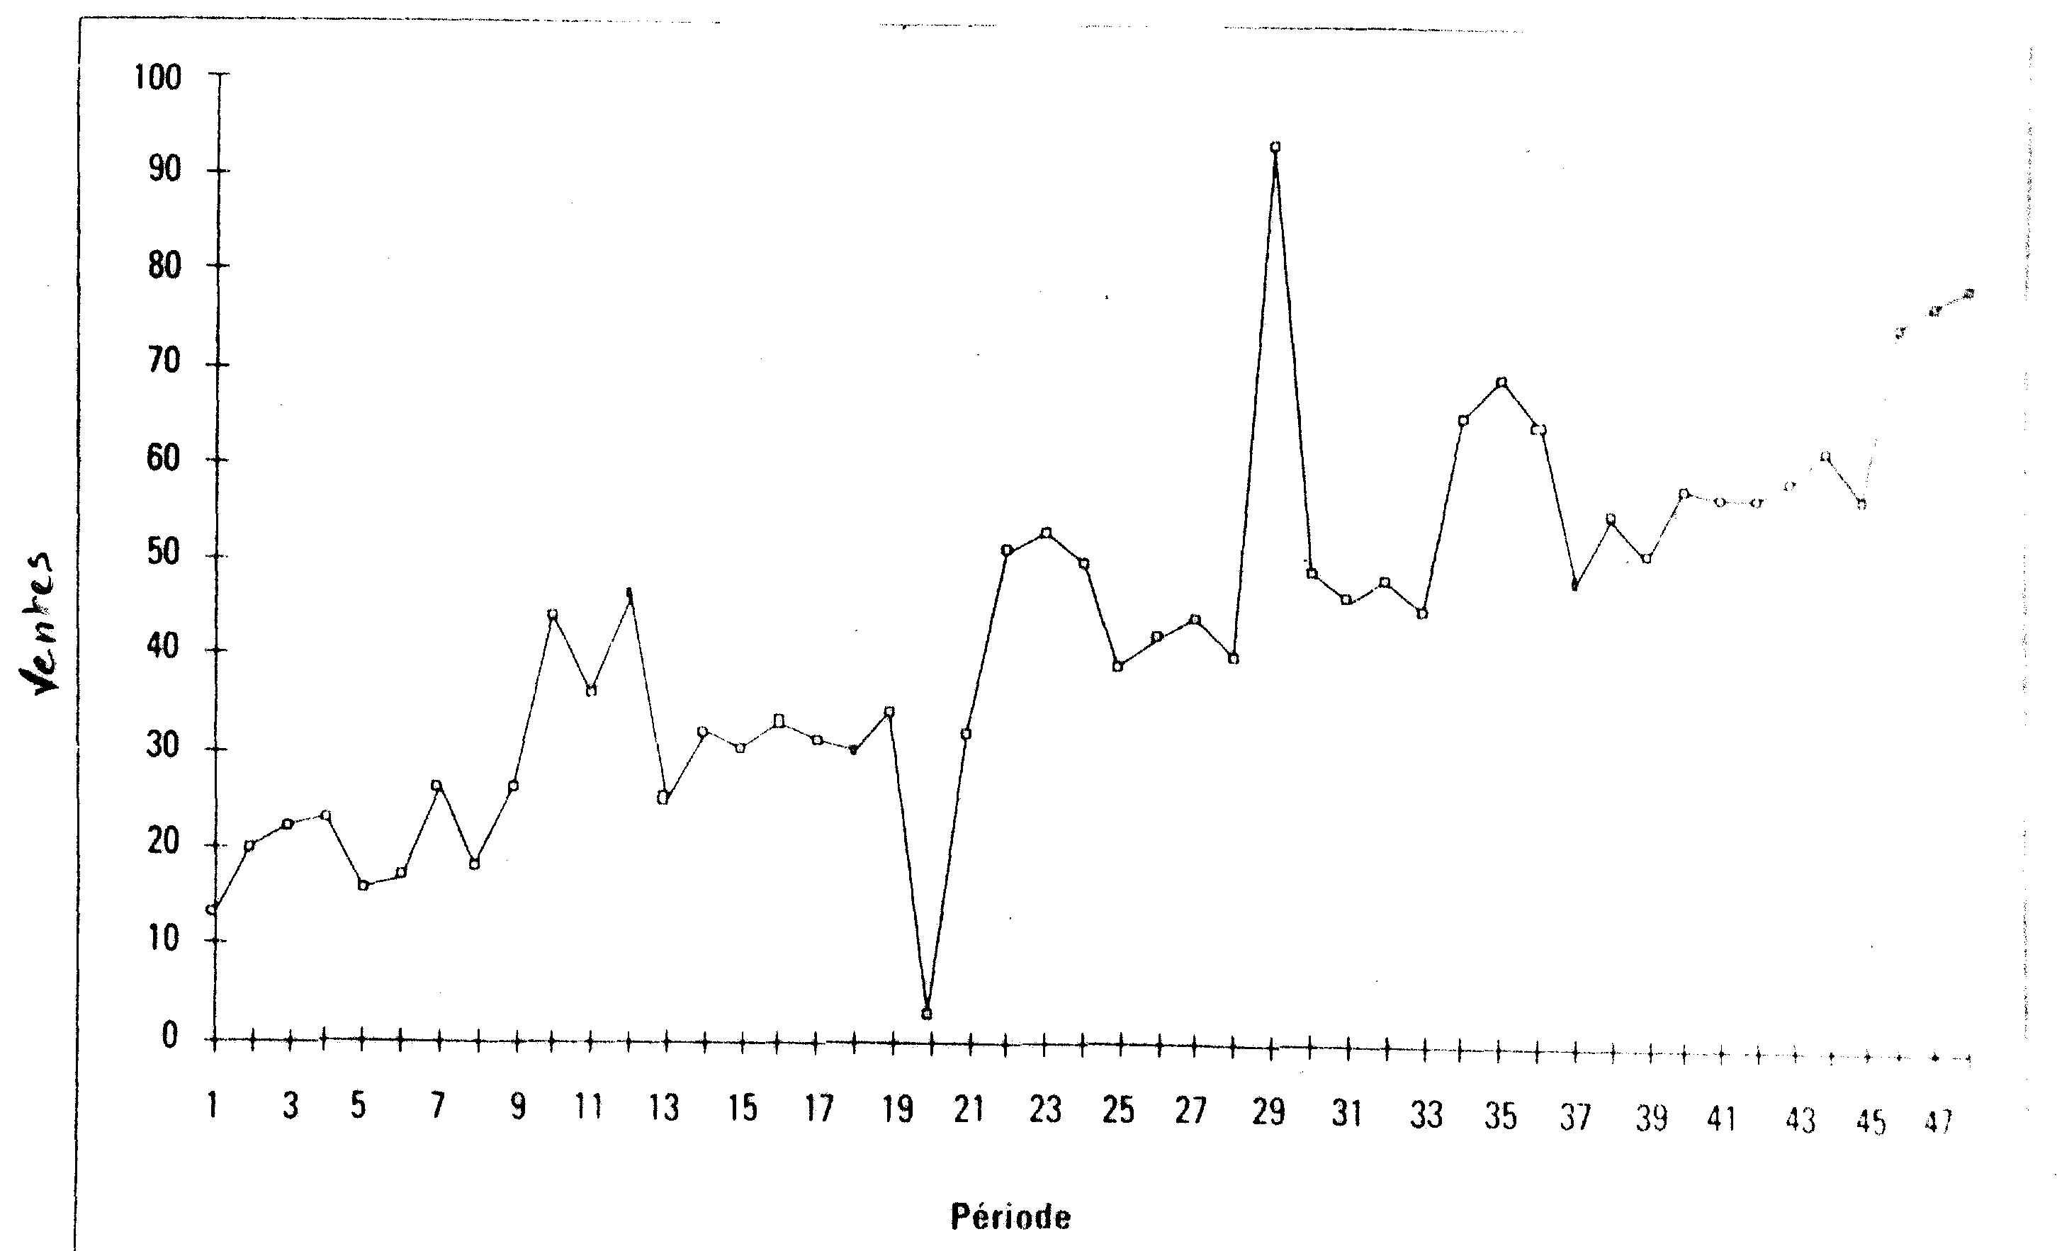
Example of a time series: Software sales
Notes:
Contexte : Il s’agit d’une entreprise de vente de logiciels.
Fort aléa sur deux périodes :
Période 20 : déménagement de l’entreprise (baisse des ventes)
Période 30 : organisation d’un salon (augmentation des ventes)

Slide 12
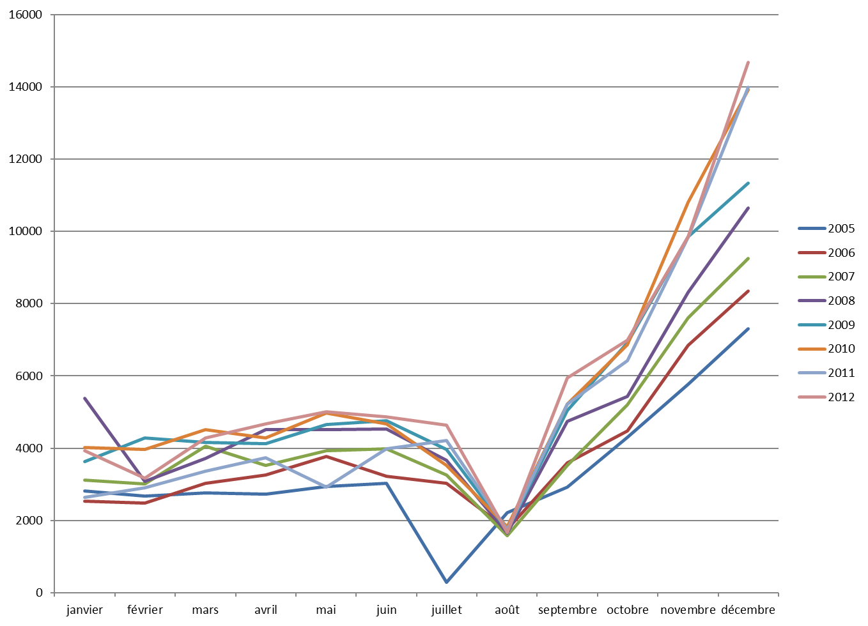
Champagne Sales
Notes:
Overlapping time plots

Slide 13
The 6 steps
1. Gathering the data (historical data)
2. Viewing
3. Choosing a model
4. Decomposing the series
5. Extrapolating and forecasting
6. Assessing the quality of the model

Slide 14
Step 3. Choosing a model
Additive : y(t) = T + S + Ɛ
There is an implicit assumption that the amplitude of the seasonal fluctuations is relatively the same each period, it is not affected by the general trend.
Multiplicative : y(t) = T . S . Ɛ
This models assumes that the seasonal (and other) effects act proportionally on the series such that seasonal variation increases over time.
CH & RJ & LF/ 2018
Notes:
CH & RJ & LF/ 2018

Slide 15
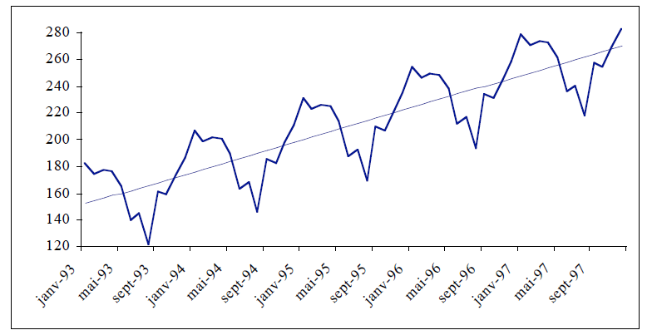
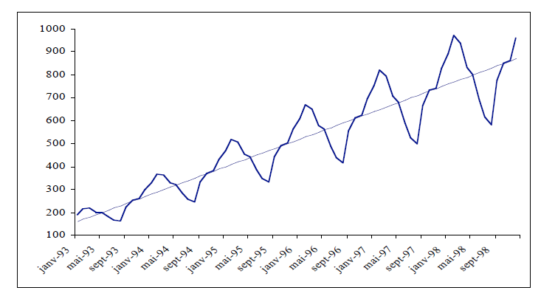
Choosing a model
Example of an additive model
Monthly produced quantities
Example of a multiplicative model
Monthly produced quantities

Slide 16
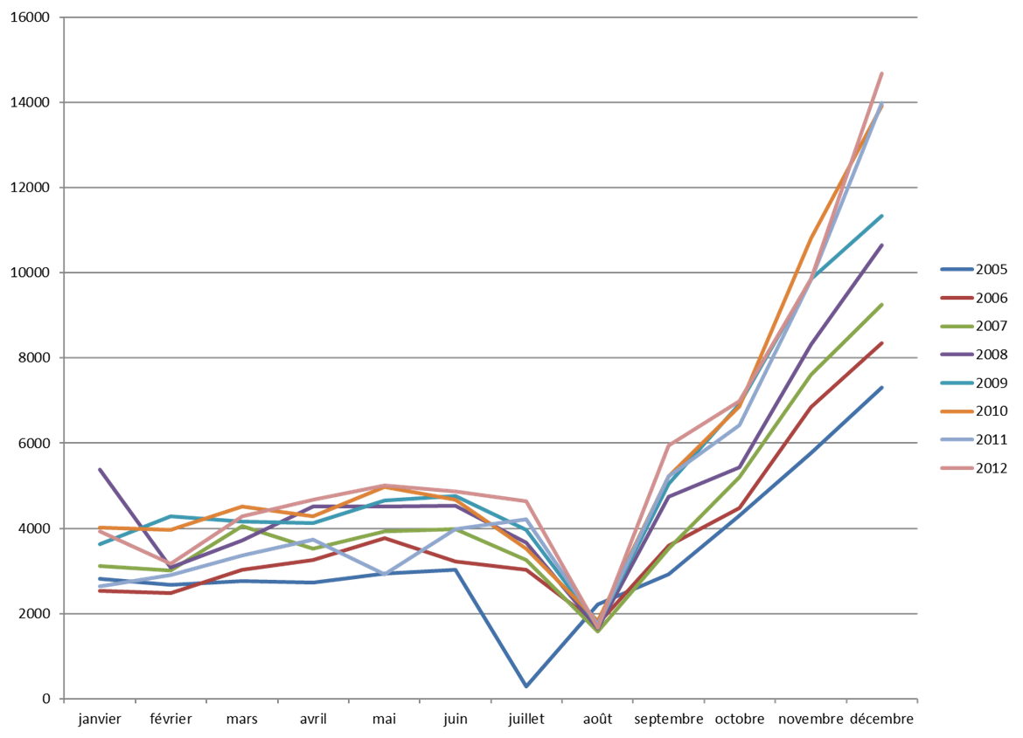
Champagne Sales

Slide 17
Example 2: Air Traffic
Jan - Feb | Mar - Apr | May - Jun | Jul - Aug | Sept- Oct | Nov - Dec
3357 | 3811 | 4189 | 4389 | 4351 | 3580
3457 | 3842 | 4282 | 4496 | 4438 | 3645
3395 | 4086 | 4405 | 4538 | 4533 | 3824
3440 | 4002 | 4240 | 4675 | 4198 | 3843
1928 | 4393 | 4620 | 4975 | 5027 | 4386
4204 | 4706 | 5118 | 5302 | 5462 | 4640
4613 | 5258 | 5701 | 5872 | 5982 | 5241

Slide 18
Air Traffic
1 | 3357
2 | 3811
3 | 4189
4 | 4389
5 | 4351
6 | 3580
7 | 3457
8 | 3842
9 | 4282
10 | 4496
11 | 4438
12 | 3645
13 | 3395
14 | 4086
15 | 4405
16 | 4538
17 | 4533
18 | 3824
19 | 3440
20 | 4002
21 | 4240
22 | 4675
23 | 4198
24 | 3843
25 | 1928
26 | 4393
… | …

Slide 19
Air Traffic

Slide 20
Air Traffic
1 | 3357 | 3357
2 | 3811 | 3811
3 | 4189 | 4189
4 | 4389 | 4389
5 | 4351 | 4351
6 | 3580 | 3580
7 | 3457 | 3457
8 | 3842 | 3842
9 | 4282 | 4282
10 | 4496 | 4496
11 | 4438 | 4438
12 | 3645 | 3645
13 | 3395 | 3395
14 | 4086 | 4086
15 | 4405 | 4405
16 | 4538 | 4538
17 | 4533 | 4533
18 | 3824 | 3824
19 | 3440 | 3440
20 | 4002 | 4002
21 | 4240 | 4240
22 | 4675 | 4675
23 | 4198 | 4198
24 | 3843 | 3843
25 | 1928 | 3800
26 | 4393 | 4393
27 | 4620 | 4620
28 | 4975 | 4975
29 | 5027 | 5027
30 | 4386 | 4386
31 | 4204 | 4204
32 | 4706 | 4706
33 | 5118 | 5118
… | … | …

Slide 21
The 6 steps
1. Gathering the data (historical data)
2. Viewing
3. Choosing a model
4. Decomposing the series
5. Extrapolating and forecasting
6. Assessing the quality of the model

Slide 22
Step 4. Decomposing the series
4.1 Smoothing the time series
4.2 Determining the seasonal component
4.3 Extracting the trend using the seasonally adjusted series

Slide 23
Step 4.1: Smoothing the time series
Smoothing the original series helps identify the trend T by taking away the seasonal effect S.
We get a new series MA_{p}(t), called a Moving Average of period length p:
Average because we determine the averages of observed values of a variable that surround a particular time t;
Moving because it is calculated at each point t in time.
Notes:
En finance, on repère des signaux d’achat ou de vente sur les marchés boursiers via les moyennes mobiles : on utilise 2 moyennes mobiles, une courte et une longue.
Si la moyenne mobile courte passe au dessus de la moyenne mobile longue, un signal d’achat est lancé.

Slide 24
Calculating Moving Averages
The moving averages method consists of replacing each value y(t) at a point in time by the average of p observed values that surround it:
(p-1)/2 preceding values, the given value, (p-1)/2 following values.
Calculation example when the period length is odd:
t | y(t) | MA₃(t) | MA₅(t)
1 | 12
2 | 2
3 | 7
4 | 24
5 | 5
6 | 1

Slide 25
Calculating Moving Averages
The moving averages method consists of replacing each value y(t) at a point in time by the average of p observed values that surround it:
(p-1)/2 preceding values, the given value, (p-1)/2 following values.
Calculation example when the period length is odd:
t | y(t) | MA₃(t) | MA₅(t)
1 | 12
2 | 2 | MA₃(2)=(12+2+7)/3=7
3 | 7
4 | 24
5 | 5
6 | 1

Slide 26
Calculating Moving Averages
The moving averages method consists of replacing each value y(t) at a point in time by the average of p observed values that surround it:
(p-1)/2 preceding values, the given value, (p-1)/2 following values.
Calculation example when the period length is odd:
t | y(t) | MA₃(t) | MA₅(t)
1 | 12
2 | 2 | MA₃(2)=(12+2+7)/3=7
3 | 7 | 11
4 | 24 | 12
5 | 5 | 10
6 | 1

Slide 27
Calculating Moving Averages
The moving averages method consists of replacing each value y(t) at a point in time by the average of p observed values that surround it:
(p-1)/2 preceding values, the given value, (p-1)/2 following values.
Calculation example when the period length is odd:
t | y(t) | MA₃(t) | MA₅(t)
1 | 12
2 | 2 | MA₃(2)=(12+2+7)/3=7
3 | 7 | 11 | MA₅(3)=(12+2+…+5)/5=10
4 | 24 | 12 | 7.8
5 | 5 | 10
6 | 1

Slide 28
Period length for Moving Averages
The period length of a moving average equal to the seasonal span.
The time series we will be dealing with are most commonly data from businesses for which we use yearly breakdown.
To smooth away seasonality in monthly data we use MA₁₂; to smooth away seasonality in quarterly data we use MA₄; etc…

Slide 29
Air Traffic
 |  | y(t)
J/F année1 | 1 | 3357
M/A année1 | 2 | 3811
M/J année1 | 3 | 4189
J/A année1 | 4 | 4389
S/O année1 | 5 | 4351
N/D année1 | 6 | 3580
J/F année2 | 7 | 3457
M/A année2 | 8 | 3842
Notes:
Dans le cas de données mensuelles, les six premières et les six dernières données sont perdues!

Slide 30
Air Traffic
 |  | y(t) | MM₆(t)
J/F année1 | 1 | 3357
M/A année1 | 2 | 3811
M/J année1 | 3 | 4189
J/A année1 | 4 | 4389 | MM₆(4)= (0,5. 3357+3811+4189+4389+4351+3580+0,5.3457) / 6 = 3954,50
S/O année1 | 5 | 4351
N/D année1 | 6 | 3580
J/F année2 | 7 | 3457
M/A année2 | 8 | 3842
Notes:
Dans le cas de données mensuelles, les six premières et les six dernières données sont perdues!

Slide 31
Air Traffic
 |  | y(t) | MM₆(t)
J/F année1 | 1 | 3357
M/A année1 | 2 | 3811
M/J année1 | 3 | 4189
J/A année1 | 4 | 4389 | MM₆(4)= (0,5. 3357+3811+4189+4389+4351+3580+0,5.3457) / 6 = 3954,50
S/O année1 | 5 | 4351 | 3965,42
N/D année1 | 6 | 3580 | 3975,75
J/F année2 | 7 | 3457 | 3992,42
M/A année2 | 8 | 3842 | 4008,58
Notes:
Dans le cas de données mensuelles, les six premières et les six dernières données sont perdues!

Slide 32
Air Traffic
 |  | y(t) | MM₆(t)
J/F année1 | 1 | 3357
M/A année1 | 2 | 3811
M/J année1 | 3 | 4189
J/A année1 | 4 | 4389 | MM₆(4)= (0,5. 3357+3811+4189+4389+4351+3580+0,5.3457) / 6 = 3954,50
S/O année1 | 5 | 4351 | 3965,42
N/D année1 | 6 | 3580 | 3975,75
J/F année2 | 7 | 3457 | 3992,42
M/A année2 | 8 | 3842 | 4008,58
Notes:
Dans le cas de données mensuelles, les six premières et les six dernières données sont perdues!

Slide 33
Air Traffic

Slide 34
Champagne Sales
Rank of Month | Sales | MA12
1 | 2815
2 | 2672
3 | 2755
4 | 2721
5 | 2946
6 | 3036
7 | 2282 | 3466,75
8 | 2212 | 3447,125
9 | 2922 | 3450,416667
10 | 4301 | 3484,625
11 | 5764 | 3541,916667
12 | 7312 | 3584,583333
13 | 2541 | 3623,75
14 | 2475 | 3635,958333
15 | 3031 | 3645,125
16 | 3266 | 3680,375
17 | 3776 | 3732,333333
18 | 3230 | 3820,625
19 | 3028 | 3888
3466,75 =
(2815/2+2672+2755+2721+2946+3036+2282+2212+2922+4301+5764+7312+2541/2)/12

Slide 35
Champagne Sales

Slide 36
Step 4.2: Determining the seasonal component
4 sub-steps:
Calculate the seasonal differences/ratios
Calculate the seasonal coefficients, s_{j}
Check the conservation principle: rescale the coefficients to s’_{j}
Interpret the coefficients
Notes:
Seasonal coefficients are also called seasonal factors or seasonal indices

Slide 37

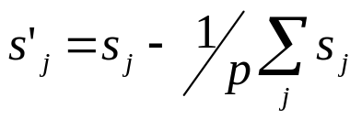
Seasonal Component: Additive Model
1. Calculate the seasonal differences: s(t) = y(t) – MA_{p}(t)
2. Calculate the seasonal coefficients, s_{j}: average all the s(t) of the same rank (for each month or each quarter j). We get p seasonal coefficients s_{j} (12 coefficients for monthly data, 4 coefficients for quarterly data).
3. Check the conservation principle:
In case it is not respected, rescale the coefficients as follows:
4. Interpret the coefficients.

Slide 38
Air Traffic
T+S+ε
T
S+ε
t | y(t) | MA6(t) | seasonal differences
1 | 3357
2 | 3811
3 | 4189
4 | 4389 | 3954,50 | 434,50
5 | 4351 | 3965,42 | 385,58
6 | 3580 | 3975,75 | -395,75
7 | 3457 | 3992,42 | -535,42
8 | 3842 | 4008,58 | -166,58
9 | 4282 | 4021,25 | 260,75
10 | 4496 | 4021,50 | 474,50
11 | 4438 | 4036,67 | 401,33
12 | 3645 | 4067,25 | -422,25
13 | 3395 | 4081,00 | -686,00
14 | 4086 | 4092,42 | -6,42
15 | 4405 | 4115,25 | 289,75
16 | 4538 | 4133,92 | 404,08
17 | 4533 | 4130,67 | 402,33
18 | 3824 | 4109,92 | -285,92
19 | 3440 | 4107,58 | -667,58
20 | 4002 | 4091,08 | -89,08
21 | 4240 | 4064,75 | 175,25
22 | 4675 | 4096,33 | 578,67
23 | 4198 | 4158,92 | 39,08
24 | 3843 | 4223,17 | -380,17
25 | 3800 | 4279,83 | -479,83
26 | 4393 | 4373,92 | 19,08
27 | 4620 | 4488,25 | 131,75
28 | 4975 | 4567,17 | 407,83
29 | 5027 | 4626,92 | 400,08
30 | 4386 | 4694,50 | -308,50
31 | 4204 | 4763,25 | -559,25
32 | 4706 | 4826,75 | -120,75
33 | 5118 | 4884,17 | 233,83
34 | 5302 | 4939,42 | 362,58
35 | 5462 | 5019,50 | 442,50
36 | 4640 | 5114,08 | -474,08
37 | 4613 | 5210,17 | -597,17
38 | 5258 | 5301,00 | -43,00
39 | 5701 | 5394,42 | 306,58
40 | 5872
41 | 5982
42 | 5241

Slide 39
Air Traffic
T+S+ε
T
S+ε
434,50 = 4389 - 3954,50
t | y(t) | MA6(t) | seasonal differences
1 | 3357
2 | 3811
3 | 4189
4 | 4389 | 3954,50 | 434,50
5 | 4351 | 3965,42 | 385,58
6 | 3580 | 3975,75 | -395,75
7 | 3457 | 3992,42 | -535,42
8 | 3842 | 4008,58 | -166,58
9 | 4282 | 4021,25 | 260,75
10 | 4496 | 4021,50 | 474,50
11 | 4438 | 4036,67 | 401,33
12 | 3645 | 4067,25 | -422,25
13 | 3395 | 4081,00 | -686,00
14 | 4086 | 4092,42 | -6,42
15 | 4405 | 4115,25 | 289,75
16 | 4538 | 4133,92 | 404,08
17 | 4533 | 4130,67 | 402,33
18 | 3824 | 4109,92 | -285,92
19 | 3440 | 4107,58 | -667,58
20 | 4002 | 4091,08 | -89,08
21 | 4240 | 4064,75 | 175,25
22 | 4675 | 4096,33 | 578,67
23 | 4198 | 4158,92 | 39,08
24 | 3843 | 4223,17 | -380,17
25 | 3800 | 4279,83 | -479,83
26 | 4393 | 4373,92 | 19,08
27 | 4620 | 4488,25 | 131,75
28 | 4975 | 4567,17 | 407,83
29 | 5027 | 4626,92 | 400,08
30 | 4386 | 4694,50 | -308,50
31 | 4204 | 4763,25 | -559,25
32 | 4706 | 4826,75 | -120,75
33 | 5118 | 4884,17 | 233,83
34 | 5302 | 4939,42 | 362,58
35 | 5462 | 5019,50 | 442,50
36 | 4640 | 5114,08 | -474,08
37 | 4613 | 5210,17 | -597,17
38 | 5258 | 5301,00 | -43,00
39 | 5701 | 5394,42 | 306,58
40 | 5872
41 | 5982
42 | 5241

Slide 40
Air Traffic
T+S+ε
T
S+ε
t | y(t) | MM6(t) | seasonal differences
1 | 3357
2 | 3811
3 | 4189
4 | 4389 | 3954,50 | 434,50
5 | 4351 | 3965,42 | 385,58
6 | 3580 | 3975,75 | -395,75
7 | 3457 | 3992,42 | -535,42
8 | 3842 | 4008,58 | -166,58
9 | 4282 | 4021,25 | 260,75
10 | 4496 | 4021,50 | 474,50
11 | 4438 | 4036,67 | 401,33
12 | 3645 | 4067,25 | -422,25
13 | 3395 | 4081,00 | -686,00
14 | 4086 | 4092,42 | -6,42
15 | 4405 | 4115,25 | 289,75
16 | 4538 | 4133,92 | 404,08
17 | 4533 | 4130,67 | 402,33
18 | 3824 | 4109,92 | -285,92
19 | 3440 | 4107,58 | -667,58
20 | 4002 | 4091,08 | -89,08
21 | 4240 | 4064,75 | 175,25
22 | 4675 | 4096,33 | 578,67
23 | 4198 | 4158,92 | 39,08
24 | 3843 | 4223,17 | -380,17
25 | 3800 | 4279,83 | -479,83
26 | 4393 | 4373,92 | 19,08
s₄ = (434,5+474,5+404,08+578,67+407,83+362,58)/6
= 443,69
27 | 4620 | 4488,25 | 131,75
28 | 4975 | 4567,17 | 407,83
29 | 5027 | 4626,92 | 400,08
30 | 4386 | 4694,50 | -308,50
31 | 4204 | 4763,25 | -559,25
32 | 4706 | 4826,75 | -120,75
33 | 5118 | 4884,17 | 233,83
34 | 5302 | 4939,42 | 362,58
35 | 5462 | 5019,50 | 442,50
36 | 4640 | 5114,08 | -474,08
37 | 4613 | 5210,17 | -597,17
38 | 5258 | 5301,00 | -43,00
39 | 5701 | 5394,42 | 306,58
40 | 5872
41 | 5982
42 | 5241

Slide 41
Air Traffic
Calculating seasonal coefficients s_{j} :
s₁ = -587,54
s₂ = -67,79
s₃ = 232,99
s₄ = 443,69
s₅ = 345,15
s₆ = -377,78
Rescaling seasonal coefficients s’_{j} :
s’₁ = (-587,54) – (-1,88) = -585,66
s'₂ = -65,91
s'₃ = 234,87
s'₄ = 445,57
s'₅ = 347,03
s'₆ = -375,90
Σs_{j} = -11,28
-11,28 / 6 = -1,88
Σs’_{j} = 0

Slide 42

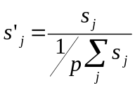
Seasonal Component: Multiplicative Model
1. Calculate the seasonal ratios: s(t) = y(t) / MA_{p}(t)
2. Calculate the seasonal coefficients, s_{j}: average all the s(t) of the same rank (for each month or each quarter j). We get p seasonal coefficients s_{j} (12 coefficients for monthly data, 4 coefficients for quarterly data).
3. Check the conservation principle:
In case it is not respected, rescale the coefficients as follows:
4. Interpret the coefficients.

Slide 43
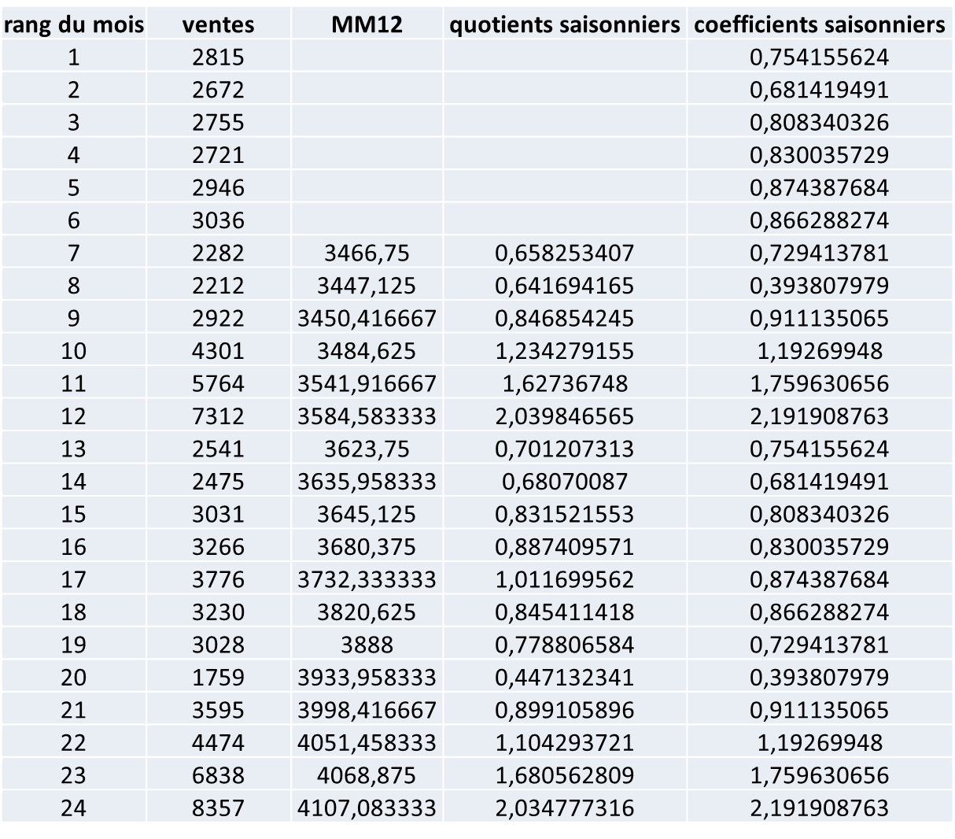
Champagne Sales
t | y(t) | MA12(t) | seasonal ratios | seasonal coefficients

Slide 44
Champagne Sales
Calculating seasonal coefficients s_{j}
s₁ = 0,754
s₂ = 0,681
s₃ = 0,808
s₄ = 0,83
s₅ = 0,874
s₆ = 0,866
s₇ = 0,729
s₈ = 0,394
s₉ = 0,911
s₁₀ = 1,192
s₁₁ = 1,76
s₁₂ = 2,191
Σs_{j} = 12
No need to rescale, s_{j} = s’_{j}

Slide 45
Step 4.3: Extracting the trend using the seasonally adjusted series
After we find the seasonal component, we can deseasonalize the observed time series.
We thus obtain the seasonally adjusted series, noted as SA(t).
Additive model : SA(t) = y(t) – s’_{j}
Multiplicative model : SA(t) = y(t) / s’_{j}
Where s’_{j} is the seasonal coefficient of the corresponding month or quarter.
The obtained SA(t) is an approximation of the trend used in business and economics.
Notes:
La moyenne mobile approche la tendance mais n’est pas satisfaisante (perte de données en début et fin d’historique)

Slide 46
Air Traffic
T+S+ε
S
T+ε
t | y(t) | s(t) | SA(t)
1 | 3357 | -585,66 | 3943
2 | 3811 | -65,91 | 3877
3 | 4189 | 234,87 | 3954
4 | 4389 | 445,57 | 3943
5 | 4351 | 347,03 | 4004
6 | 3580 | -375,90 | 3956
7 | 3457 | -585,66 | 4043
8 | 3842 | -65,91 | 3908
9 | 4282 | 234,87 | 4047
10 | 4496 | 445,57 | 4050
11 | 4438 | 347,03 | 4091
12 | 3645 | -375,90 | 4021
13 | 3395 | -585,66 | 3981
14 | 4086 | -65,91 | 4152
15 | 4405 | 234,87 | 4170
16 | 4538 | 445,57 | 4092
17 | 4533 | 347,03 | 4186
18 | 3824 | -375,90 | 4200
19 | 3440 | -585,66 | 4026
20 | 4002 | -65,91 | 4068
21 | 4240 | 234,87 | 4005
22 | 4675 | 445,57 | 4229
23 | 4198 | 347,03 | 3851
24 | 3843 | -375,90 | 4219
25 | 3800 | -585,66 | 4386
3943 = 3357 – (-585,66)
26 | 4393 | -65,91 | 4459
27 | 4620 | 234,87 | 4385
28 | 4975 | 445,57 | 4529
29 | 5027 | 347,03 | 4680
30 | 4386 | -375,90 | 4762
31 | 4204 | -585,66 | 4790
32 | 4706 | -65,91 | 4772
33 | 5118 | 234,87 | 4883
34 | 5302 | 445,57 | 4856
35 | 5462 | 347,03 | 5115
36 | 4640 | -375,90 | 5016
37 | 4613 | -585,66 | 5199
38 | 5258 | -65,91 | 5324
39 | 5701 | 234,87 | 5466
40 | 5872 | 445,57 | 5426
41 | 5982 | 347,03 | 5635
42 | 5241 | -375,90 | 5617

Slide 47
Air Traffic

Slide 48
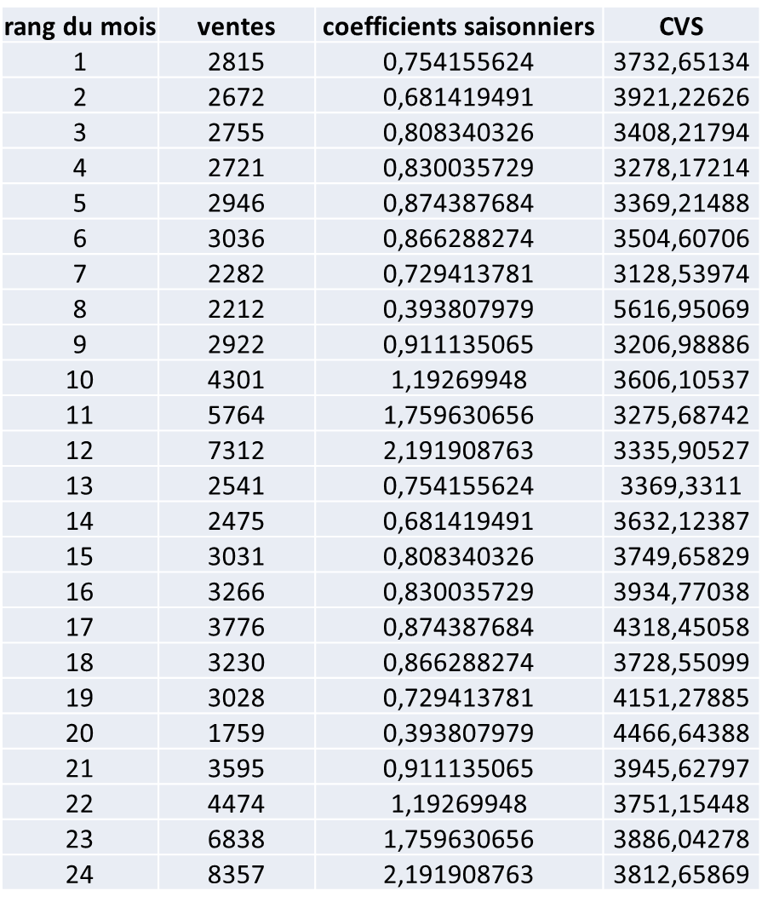
Champagne Sales
t | y(t) | s(t) | SA(t)

Slide 49
Champagne Sales
TxSxε
S
Txε
t | y(t) | s(t) | SA(t)
3732,651 = 2815 / 0,754

Slide 50
Champagne Sales

Slide 51
The 6 steps
1. Gathering the data (historical data)
2. Viewing
3. Choosing a model
4. Decomposing the series
5. Extrapolating and forecasting
6. Assessing the quality of the model

Slide 52
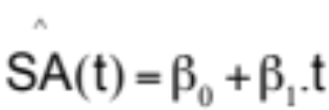
Step 5. Extrapolating and forecasting
The graph of the SA series reveals the form of the trend: linear, exponential, parabolic, ….
We then fit the SA series using a relevant model.
In the case of a linear model, we get the following equation:
𝛽₀ and 𝛽₁ are the coefficients of the linear regression using the least squares method applied to the SA(t) series.

Slide 53


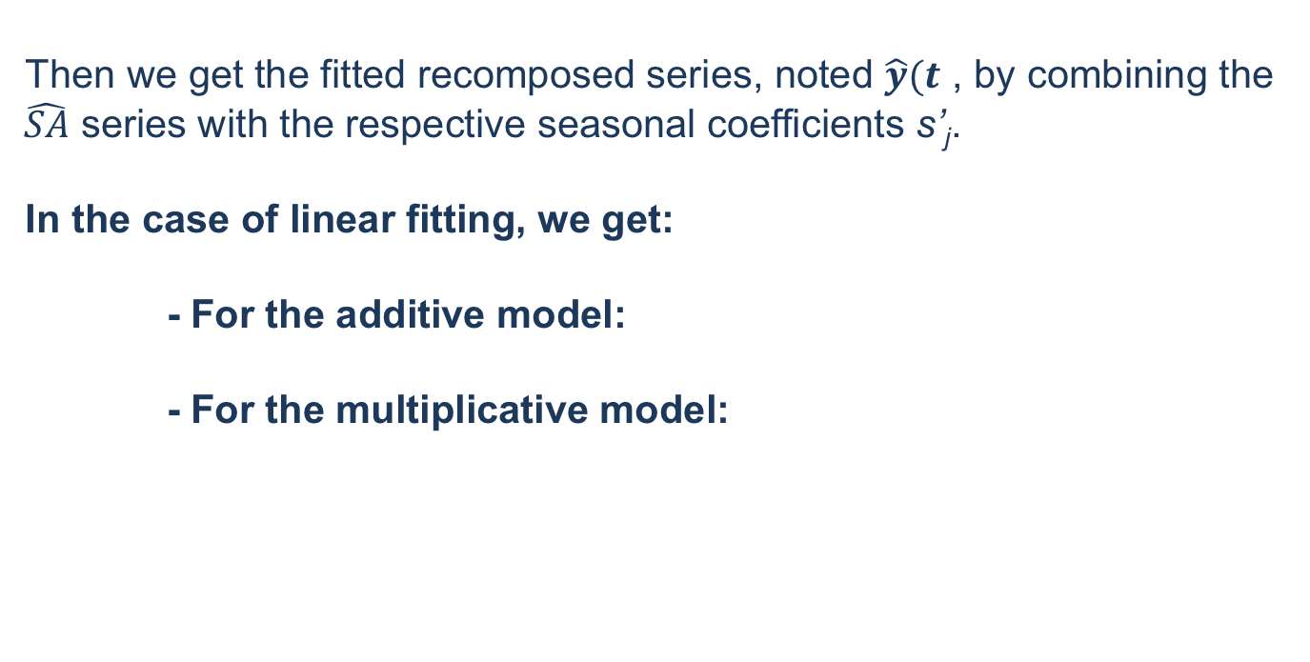
Step 5. Extrapolating and forecasting
Then we get the fitted recomposed series, noted $\hat{y}(t$ , by combining the $\hat{SA}$ series with the respective seasonal coefficients s’_{j}.
In the case of linear fitting, we get:
- For the additive model:
- For the multiplicative model:

Slide 54
Air Trafiic
Linear Model for the SA
Y-intercept | 3583,21
Slope | 39,669

Slide 55
Air Trafiic
Forecast
Jan/feb year 8
t = 43
(3583,21 + 39,669x43) + (-585,66) = 4703,05
Seasonal Coeff Jan/Feb
Fitted SA

Slide 56
Champagne Sales
Linear Model for the SA
Y-intercept | 3687,6
Slope | 22,4

Slide 57
Champagne Sales
Forecast
January 2013
t = 97
(3687,6 + 22,4x97) x 0,754 = 4418,74
Seasonal Coeff Jan
Fitted SA

Slide 58
The 6 steps
1. Gathering the data (historical data)
2. Viewing
3. Choosing a model
4. Decomposing the series
5. Extrapolating and forecasting
6. Assessing the quality of the model

Slide 59

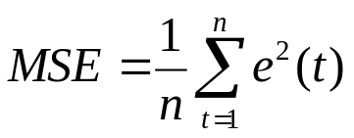
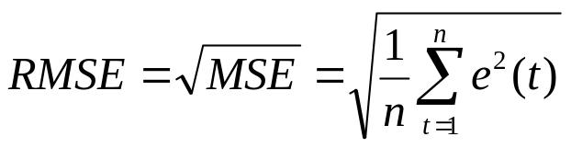
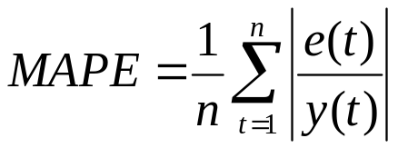
Step 6. Assessing the quality of the model
We calculate the fitting error:
Then the MSE (Mean Square Error) :
The quality of the model can be assessed through:
RMSE (Root Mean Square Error):
MAPE (Mean Absolute Percentage Error):
Notes:
MSE : moyenne de l’erreur d’ajustement au carré
MAPE : pourcentage moyen d’erreurs

Slide 60
General Procedure
1. Gathering the data (historical data)
2. Viewing
3. Choosing a model
4. Decomposing the series
5. Extrapolating and forecasting
6. Assessing the quality of the model

